Slide 1
Data Set Overview
Source: Nielsen Answers Syndicated
# of files: 6
Dimensions:
Categories: 15
Segments: 143
*List of Categories & Segment on slide 2
Time periods: 2016, 2017, 2018
Markets: State level
Metrics: $, $ YA, Units, Units YA, Promo $, Promo $ YA, No Promo $, No Promo $ YA
# of Rows: 32,000
# of Data Points: 653,581

Slide 2
Data Set Overview

Slide 3
Data Cleansing Overview
Merged all 6 files together
Adjusted formatting so that I could later create calculations:
Changed data type of several columns from Object to Float
Removed commas from values
Filled NA with 0
Dropped two columns as they are irrelevant/ inaccurate
Renamed columns for an easier read
Created calculations
Exported new file to excel

Slide 4
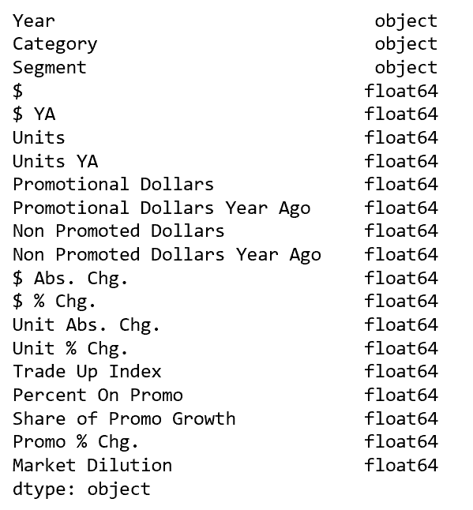
Data Cleansing Overview (dtype)
Metrics/Fields exported from Nielsen Database
Metrics created via Python

Slide 5
Example of questions that we can answer with cleansed data set
How has purchasing power increased?
How does consumer regard higher priced premium offerings?
How influential are advertisements/ promotions to consumers?
Is the market place being diluted?
Is purchasing power growth healthy or unhealthy?
Where should I price my services (only applicable if they enter consumer goods space)

